Slide 1
Pupillary Reflexes
Dr Reshmy K.R
Professor
Dept.of Physiology
SKHMC

Slide 2
Pupillary Reflexes
They are the visceral reflexes , which alter the size of pupil.
1. Light reflex
2.Ciliospinal reflex
3.Accomodation reflex

Slide 3
Light reflex( pupillary light reflex)
The reflex in which pupil constricts whenlight is flashed into the eyes
Direct light reflex
-The reflex in which there is constriction of pupil in an eye when light is thrown into that eye
Indirect light reflex ( Consensual light reflex)
-The reflex that involves constriction of pupil in both eyes when light is thrown into one eye .
Constriction of Opposite eye, eventhough no light is falling on that eye.

Slide 4
Pathway for Light reflex
Pathway for light reflex is slightly deviated from visual pathway
Fibers of light reflex pathway and the fibers of visual pathway are the same up to optic tract.
Beyond that, these two sets of fibers are separated.
Center for light reflex- Pretectal nucleus

Slide 5
Pathway for Light reflex

Slide 6
Ciliospinal reflex
The dilatation of pupil in eyes caused by painful stimulation of skin over the neck.
It is due to the contraction of dilator pupillae muscles.
Sensory impulses passes through cutaneous afferent afferent nerve
The centre is in thoracic segment.
Efferent impulses pass through sympathetic fibers and reach dilator pupillae.

Slide 7
Accomodation
Adjustment of the eye to see either near or distant objects clearly.
The process by which light rays from near objects or distant objects are brought to a focus on the sensitive point of retina by means of various adjustments in the eye ball.

Slide 8
Mechanism of Accomodation
Light rays from distant objects are approximately parallel and are less refracted while getting focused on retina.
Light rays from near objects are divergent.
So these light rays should be refracted to a greater extent

Slide 9
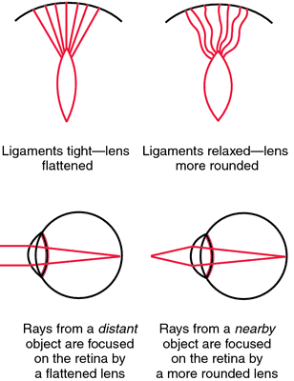
Mechanism of Accomodation
1. The retina must be moved towards or away from the lens.
This is done by shortening or elongation of eyeball.
so the divergent, parallel or convergent rays are focussed accurately

Slide 10
2. Lens must be moved towards or away from the retina
3. The convexity of lens must be altered , so that the refractory power of lens is altered.

Slide 11
Young -Helmholtz theory
The curvatue of lens increases and thereby , the refractory power of lens is enhanced.
During distant vision, lens is flat due to the traction of suspensory ligaments.
Suspensory ligaments extend from the capsule of lens and are attached to the ciliary processes.
The ciliary processes are attached to choroid through the ciliary muscle
Ciliary process are pulled backward and outward, suspensory ligaments are tensed up and the lens becomes flat

Slide 12
During near vision, ciliary muscle contracts and draws the choroid forward.
The ciliary processes are brought closer to lens.
Suspensory ligaments are slackened.
Lens bulges forward due to its elastic property
Ant. curvature of lens increases greatly

Slide 13
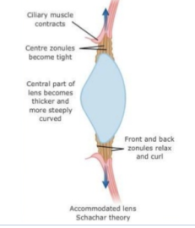
Pathway-Accomodation Reflex

Slide 14
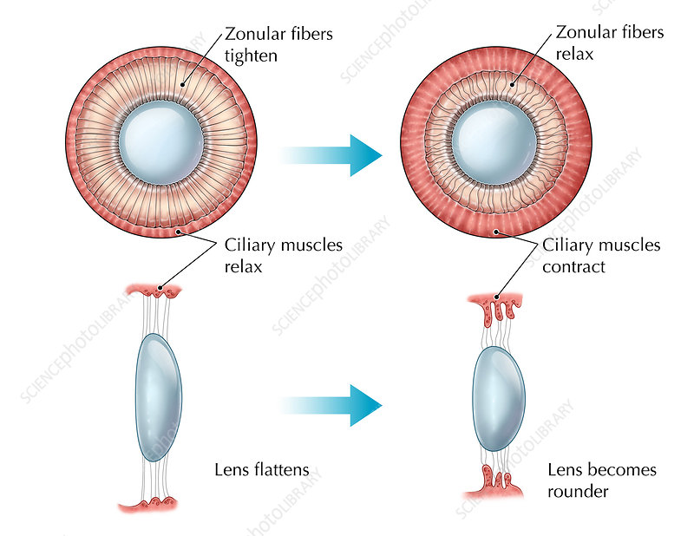
Accomodation

Slide 17
https://www.researchgate.net/figure/Schematic-drawing-of-the-pupillary-light-reflex-pathway-By-way-of-the-optic-tract-the_fig1_318593544
https://www.sciencephoto.com/media/703511/view
THANK YOU

